Slide 1
UNIT 3: PC ARCHITECTURE Assembly XV6 BOOT PROCESS
Prof Yotov
CS6233
Slides by Prof. Sandoval
Some slides derived from : Prof Dolan-Gavitt
Thanks!!!

Slide 2
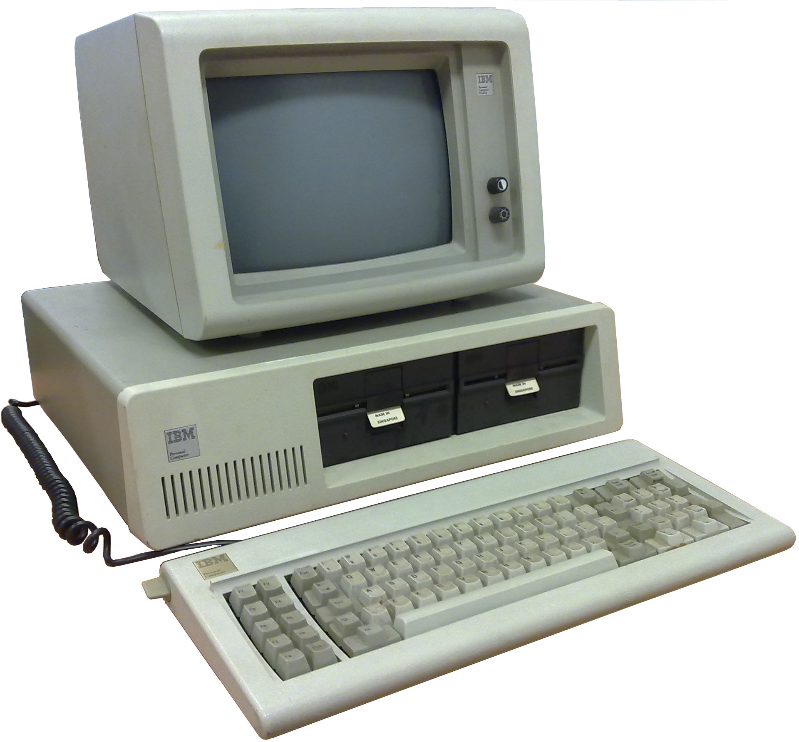
The PC

Slide 3
The PC Architecture
1981: IBM releases the IBM PC, one of the first architectures for personal computing
Wildly successful and endlessly imitated
Imitated so successfully, in fact, that the clones eventually organized and standardized the architecture, allowing compatibility between vendors

Slide 4


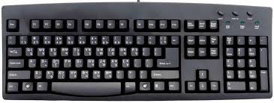



PC Architecture
(vastly simplified)
CPU
RAM
Device Controllers
Communication Bus
Notes:
We have seen this diagram before

Slide 5
PC Architecture
CPU: the part that actually carries out computations
RAM: "fast", volatile storage for code and data
Devices: the things that actually do input & output
Communications bus: typically several of these
ISA (older): original bus of the IBM PC
PCI: introduced in 1992; much faster & has automatic peripheral configuration
PCI Express: introduced 2004, dominant in PC hardware today
Notes:
ISA standard up until mid to late 90s. Fairly slow
1992 you get PCI introduced autoconfig when you plug in video card
PCI Express – GB a sec to card. Nice fast. Backwards compatibility

Slide 6
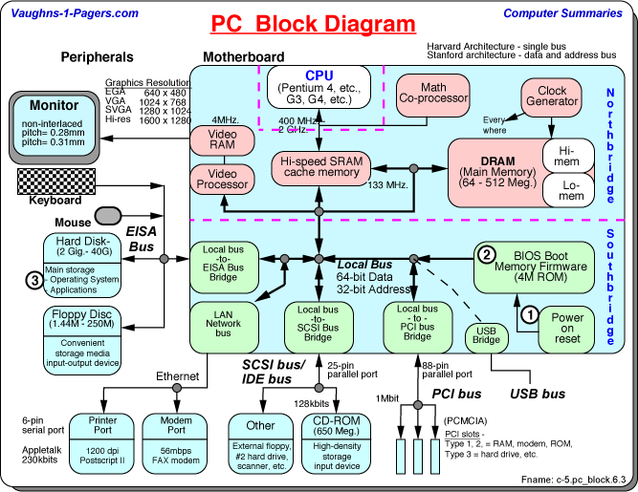
PC Architecture
(slightly less simplified)
Diagram by Vaughn Aubuchon
Notes:
Memory
2 busses – cPU / ram & peripherals. Peripherals is a little slower. Network is only say 10GB a sec
Northridge/Southridge buses

Slide 7
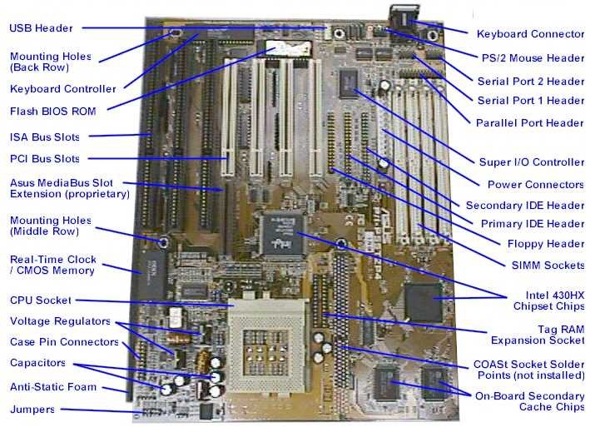
PC Architecture
Notes:
This is what it ends up looking like
RAM,PCI
SIMs – Single Inline memory – DIMs now
When you write an OS you manage all this.
It needs to manage who accesses this,

Slide 8
The BIOS
Responsible for the very first bit of code run on the system
Does some simple initialization of basic hardware
Also provides an API for hardware access
But this is typically not used except for the very early stages of boot now
Knows how to find media to boot off of, load code from them into memory, and hand off control
Notes:
Memory test or press F2 to enter BIOS
Sets the graphics mode,
It stops using the BIOS Asap and moves on to using the drivers.
Why ? BIOS is on the motherboard. If you just use the BIOS won’t take advantage of the advanced functions.
Historically they were also very buggy. Even IBMs had bugs

Slide 9
The BIOS (Originally)
Responsible for the very first bit of code run on the system
Does some simple initialization of basic hardware
Also provides an API for hardware access
But this is typically not used except for the very early stages of boot now
Knows how to find media to boot off of, load code from them into memory, and hand off control
Notes:
Memory test or press F2 to enter BIOS
Now it’s a lot more complicated.
Now it can download an OS over the network. It actually downloads a set of utitlies based on OS 9.
Sets the graphics mode,
It stops using the BIOS Asap and moves on to using the drivers.
Why ? BIOS is on the motherboard. If you just use the BIOS won’t take advantage of the advanced functions.
Historically they were also very buggy. Even IBMs had bugs
It’s been replaces on most modern machines by EFI. (Extensible) Allows vendors to extend BIOS. It’s fully extendable.
The most important is to find the device that contains the OS.

Slide 10
The BIOS (now)
A lot more complicated
It has been mostly replaced by UEFI:
Supports Remote Diagnostics and repair even with no OS installed.
Can even download an OS over the network.

Slide 11
What Does a CPU Do?
Runs a simple algorithm: pc = 0 while True: fetch instruction at address pc in RAM execute instruction if instruction did not modify pc: pc = pc + sizeof(instruction)
Notes:
It just does a couple of things:
Fetch
Execute

Slide 12
CPU
Contains a (tiny) bit of local storage (registers)
~1-3 nanoseconds to access
Contains a little more on-chip storage (cache)
~2-8 ns to access L1, 5-12 ns to access L2
For comparison: RAM is 10-60 ns, SSD is 100 µs, disk is 3-20 ms
Notes:
Nanoseconds stick
512 of L1 cache
Nano -> Micro … SSD is micro
Spinning is Milliseconds
Make sure that your algorithm works in the cache
HFD, Scientific computing care about

Slide 13
Talking to Devices
Memory-mapped I/O: A portion of the address space is mapped to a device, rather than to main memory
Port I/O:
Special CPU instructions to talk to a fixed number of I/O ports
Only 1024 I/O ports defined
Interrupts: how devices talk back
When a device wants to get the attention of the CPU, it can raise an interrupt (IRQ)
Notes:
Mmapped I/O: Depending on the place
RAM forwards it to the controllers ?
Port I/O:
Let you talk to a fixed number of I/O Ports
Interrupts:
- Sets a pin

Slide 14
RAM Layout (32-bit)
Start | End | Description
0x00000000 | 0x0009FFFF | Low Memory
0x000A0000 | 0x000BFFFF | VGA Memory
0x000C0000 | 0x000EFFFF | 16-bit Devices
0x000F0000 | 0x000FFFFF | BIOS ROM
0x00100000 | ? | Extended Memory
...
0xC0000000 | 0xFFDFFFFF | PCI Devices
0xFFE00000 | 0xFFFFFFFF | High BIOS
On Linux, you can look at /proc/iomem for a detailed list
Notes:
3GB marker -> PCI Devices
32 bit cannot access more than 3GB.
What’s the max address
64 bigs
2^64 => 2 ^52

Slide 15
x86 (32-bit)
General purpose registers: EAX, EBX, ECX, EDX, ESI, EDI (though some have historical uses: ECX is used for counters, ESI & EDI are source and destination for string operations)
Special-purpose registers: EBP (base pointer), ESP (stack pointer)
Flags register: EFLAGS
Segment registers: CS, SS, DS, ES, FS, GS
Instruction pointer/program counter: EIP
Control registers: CR0-CR4
Notes:
Historical
ECX loops
ESI, EDI source destination
RISC vs CISC => CISC do a lot more than CISC
Flags – arithmetic operations, comparison
EIP -> program counter

Slide 16
CPU Registers (x86)
31
16
8
0
EAX
AH
AL
AX
EBX
BH
BL
BX
...
ESI
SI
EDI
DI
EBP
BP
ESP
SP
Notes:
When it was 8 bits it was A, B =>
16 bit They became AX (Extended)
For 32 it’s really Extended- Extended
EAX => Extended 32 bit
You can refer to the lower 16 as AX
Each digit is 4 bits:
0xFFAAFF99
99 = AL etc…
Q: Endian matters when you refer as address not in registers

Slide 17
x86 Instructions
Instructions are variable length
Conventions:
regN means a register of N bits
mem means memory
constN means a constant of N bits

Slide 18
Note: x86 is BIG
When they stopped printing paper manuals (c. 2010), occupied Intel manual occupied 5 volumes
Two volumes (1300 pages as of June 2015) dedicated just to describing instructions
We will only cover a minimal subset of x86 here; if you have questions about a particular instruction the Intel manuals are actually pretty good
Notes:
Intel only adds features

Slide 19
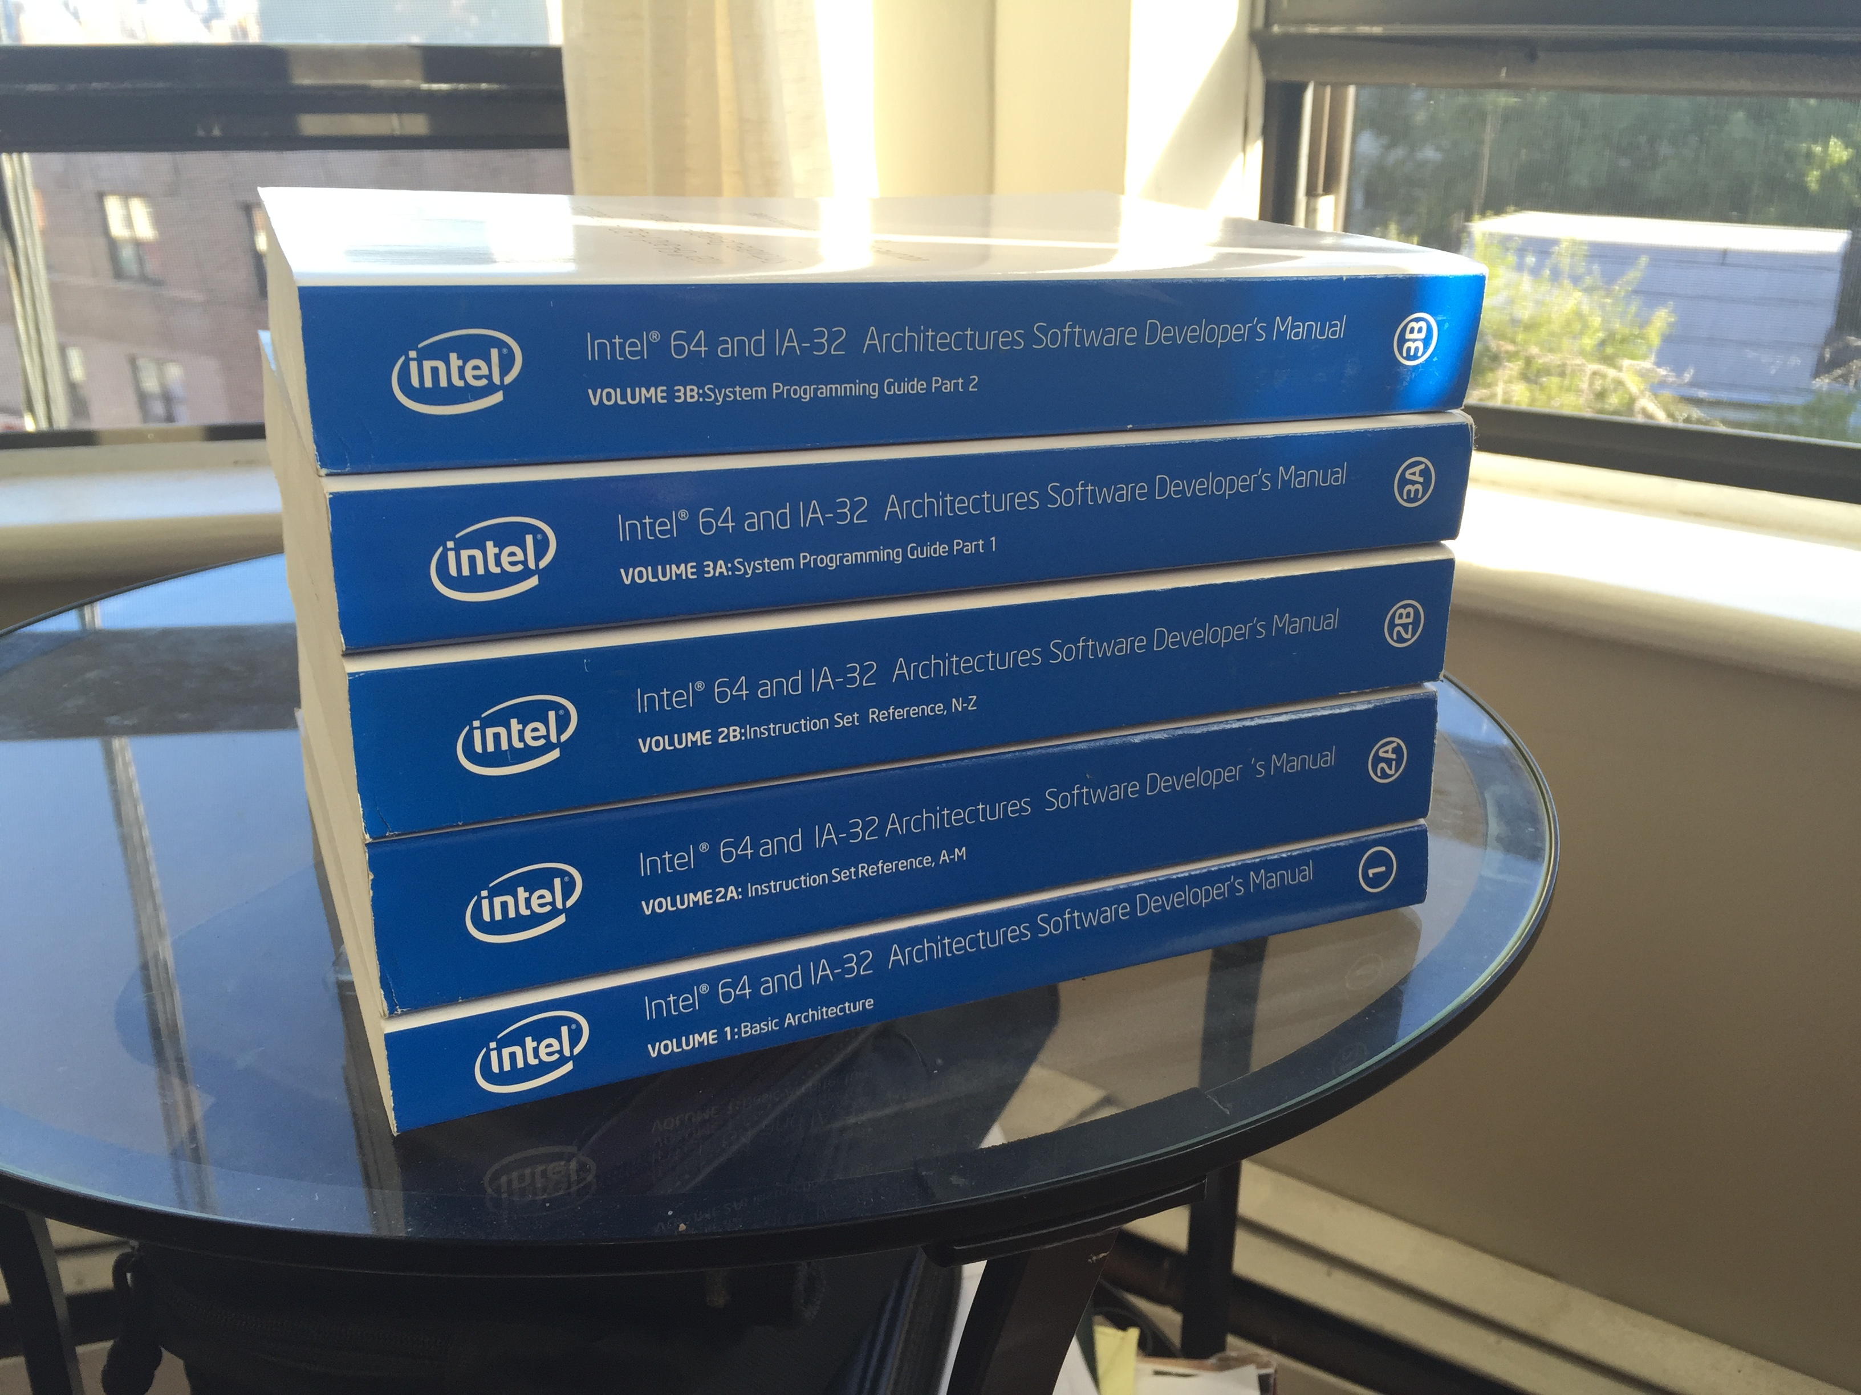

Slide 20
x86 Assembly Syntax
Two "flavors":
Intel syntax (what's in the processor manual)
AT&T syntax (what GNU as uses)
The difference between them:
Intel: mov eax, DWORD PTR [ebx]
AT&T: movl (%ebx), %eax
GNU as can be made to use Intel syntax instead with .intel_syntax noprefix
Notes:
Biggest difference the order of the operands is swapped
ATT uses %
Intel dest, source
AT&T => Source, dest
We will work with the AT&T syntax. If you see online you might need to swap

Slide 21
Data Movement
mov <reg>,<reg>
mov <reg>,<mem>
mov <mem>,<reg>
mov <reg>,<const>
mov <mem>,<const>
Notes:
Everything you would expect

Slide 22
Data Movement
Examples (AT&T syntax)
Source, dest
movl %eax, %edx => edx = eax
movl $0x123, %ebx => ebx = 0x123
movl 0x123, %ebx => ebx = *(int *)0x123
movl (%ebx), %edx => edx = *(int *)ebx
movl 4(%ebx), %edx => edx = *(int *)(ebx + 4)
Notes:
movl 0x123, - from address
Can pointers be made constant
-

Slide 23
Segmentation
Original 8086 processor had 20 address lines (i.e., bits for specifying a memory address)
But only had 16-bit registers
Segment registers provide a way to get the extra 4 bits
Segments also have permissions associated with them (not discussed here)
Modern OSes make almost no use of segments (and x86_64 gets rid of them in 64-bit mode)
Notes:
Modern OS almost no use of segmentation

Slide 24
Segmentation
cs: code segment (modifies code fetch)
ds: data segment (modifies data access)
ss: stack segment (modifies ESP & EBP)
es: extra segment (modifies string ops)
So:
movl (%bp), %bx implicitly uses the 4 bits in the ss as a prefix to %bp
Notes:
Take IP + CS -

Slide 25
Push/Pop
Recall: ESP is stack pointer
On x86 the stack grows downward – putting something on the stack decrements the stack pointer
Push subtracts 4 from ESP, then writes to the memory at address ESP
Notes:
Putting things in memory makes the SP go lower in memory

Slide 26
Arithmetic
add, sub, inc, dec
imul, idiv
and, or, xor
not
neg
shl, shr
Notes:
Imul/I
Idiv are signed
Not – 1s complement
Neg – 2s complement
You can look them up in the processor manual
Overflows look it up

Slide 27
Logical
test %x, %y – equivalent to and %x, %y but does not modify %y
cmp %x, %y – equivalent to sub %x, %y but does not modify %y
So if they don't modify the destination operand, what do they do?

Slide 28
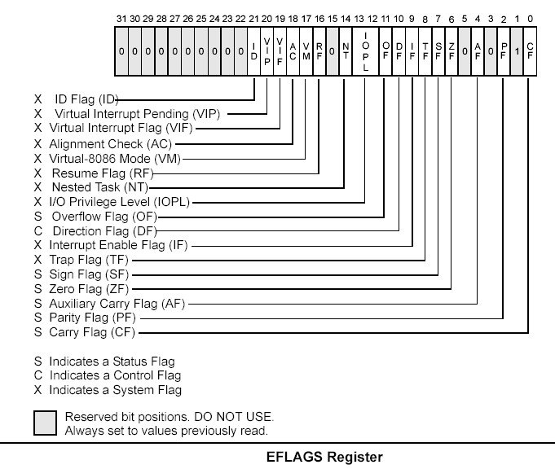
EFLAGS
Arithmetic and logical instructions set bits in EFLAGS as a side effect
Notes:
Test and compare instruction set various flags here.
Zero flag is the result of the operation is 0
Conditional branches depend on the values in Eflags
On arm you can make any instruction condictional

Slide 29
EFLAGS
Conditional branches depend on the values in EFLAGS
Also some specific instructions, e.g. cmov, will be executed only when flags are satisfied
Other architectures take this even further: on ARM, almost any instruction can be made conditional

Slide 30
Unconditional Branch
jmp: unconditional jump
jmp <const> – jump to constant address
jmp <mem> – dereference mem and jump
jmp <reg> - jump to address in register

Slide 31
Conditional Branches
Instruction | Description | signed-ness | Flags
JO | Jump if overflow |  | OF = 1
JNO | Jump if not overflow |  | OF = 0
JS | Jump if sign |  | SF = 1
JNS | Jump if not sign |  | SF = 0
JE JZ | Jump if equal Jump if zero |  | ZF = 1
JNE JNZ | Jump if not equal Jump if not zero |  | ZF = 0
JB JNAE JC | Jump if below Jump if not above or equal Jump if carry | unsigned | CF = 1
JNB JAE JNC | Jump if not below Jump if above or equal Jump if not carry | unsigned | CF = 0
JBE JNA | Jump if below or equal Jump if not above | unsigned | CF = 1 or ZF = 1
JA JNBE | Jump if above Jump if not below or equal | unsigned | CF = 0 and ZF = 0
JL JNGE | Jump if less Jump if not greater or equal | signed | SF <> OF
JGE JNL | Jump if greater or equal Jump if not less | signed | SF = OF
JLE JNG | Jump if less or equal Jump if not greater | signed | ZF = 1 or SF <> OF
JG JNLE | Jump if greater Jump if not less or equal | signed | ZF = 0 and SF = OF
JP JPE | Jump if parity Jump if parity even |  | PF = 1
JNP JPO | Jump if not parity Jump if parity odd |  | PF = 0
JCXZ JECXZ | Jump if %CX register is 0 Jump if %ECX register is 0 |  | %CX = 0 %ECX = 0

Slide 32
Call & Return
Supports creation of functions
call <f>: push the address of next instruction on the stack and jump to f Example: 1000 call <f> // pushes 5 and jumps to f 1005 movl %eax, %ebx
ret: pop return address off the stack and jump to it
Notes:
Call =
Push 1005
Jmp <f>
Push/pop -> adding and subtracting

Slide 33
String
lodsb, stosb: loads or stores a byte from %esi or %edi and increments %esi/%edi
movsb: move byte from (%esi) to (%edi) and increments both
scasb: compares %(es:edi) with %al and sets flags, then increments %edi
String operations can be used with the repCC prefix, which repeats the instruction while a condition CC is true
Note: this is one of the many things that makes x86 a CISC assembly language rather than RISC
Notes:
In RISC you wn’t have things for manipulating strings

Slide 34
System
Many instructions control system behavior
int – executes a software interrupt (traps into the kernel)
iret – return from an interrupt
sysenter/sysret – newer way to enter/leave kernel mode
Notes:
Int – transfers control to the kernel
Put arguments in the stack and then execute a software interrupt
From priviliged, to privileged kernel mode
Iret- from kernel to user mode
Int/ret is the older mode
Newer mode: sysenter/sysret do most of the same

Slide 35
Stack Frames
Inside of a function, we want access to function arguments, as well as have space for local variables
To do so, functions typically use the %ebp register to point to the value %esp had at function entry
Then, they reserve space on the stack for locals
So: stack arguments can be accessed with %(ebp)

Slide 36
Function Prologue & Epilogue
The need to set up a stack frame gives rise to a common function prologue: push %ebp // save old value of ebp mov %esp, %ebp // set base p sub $X, %esp // reserve space for locals
At the end, we can clean up with just the epilogue mov %ebp, %esp // restore stack pointer pop %ebp // restore base pointer ret // return pops return address
Notes:
Base pointer is a convenient way to get access to the base

Slide 37
Walking the Call Stack
int AddMe(int a, int b)
{
int c;
c = a + b;
return c;
}
main()
{
AddMe(10,20);
print…
}
High memory
ESP

Slide 38
Walking the Call Stack
int AddMe(int a, int b)
{
int c;
c = a + b;
return c;
}
main()
{
AddMe(10,20);
print…
}
High memory
20
Args to AddMe
10
ESP
Notes:
Arguments are pushed in reverse order, why ?

Slide 39
Walking the Call Stack
int AddMe(int a, int b)
{
int c;
c = a + b;
return c;
}
main()
{
AddMe(10,20);
print…
}
High memory
20
Args to AddMe
10
ret
ESP
Notes:
Before calling addMe we need to store the return value
So we push that into the stack
When we call addMe ESP is pointing to the top of the stack.
The problem is that in the new function we might need to use ESP

Slide 40
Walking the Call Stack
int AddMe(int a, int b)
{
int c;
c = a + b;
return c;
}
main()
{
AddMe(10,20);
print…
}
High memory
20
Args to AddMe
10
ret
EBP - old
ESP
EBP new
Notes:
So we push the old EBP
And copy the ESP -> EBP

Slide 41
Walking the Call Stack
int AddMe(int a, int b)
{
int c;
c = a + b;
return c;
}
main()
{
AddMe(10,20);
print…
}
High memory
20
Args to AddMe
10
ret
EBP - old
Int C
EBP new
ESP
Notes:
When we go into the function, we also save space for the local variables in the stack
On returning the opposite is done:
Restore the stack pointer
Restore the base pointer
Return

Slide 42
To reference data on the stack
High memory
20
12(%EBP)
10
8(%EBP)
ret
4(%EBP)
EBP - old
(%EBP)
Int C
EBP
-4(%EBP)
ESP
Notes:
We use the indirect mode

Slide 43
Aside: Buffer Overflow
Consider a function like: int f(int arg1, int arg2) { char x[4]; ... }
Stack frame for function shown at right
Suppose inside f, we write past the end of array x?
What gets overwritten? What happens when we execute ret?
x[0]
x[1]
x[2]
x[3]
saved base pointer
return address
arg1
arg2

Slide 44
Calling Conventions
A calling convention is a system-defined convention that tells you how to call a function
In general a calling convention will:
Say how to pass arguments to the function
Say who is responsible for cleaning up arguments
Specify where the return value will be placed
Say which registers will be preserved by the callee and which might be trashed
Notes:
Important there is a specified standard
I end up with a binary copy of that library
So that we know which portions of the CPU state I can count on
Pass args-> push in the stack, put in the
32 bit and the gcc compiler calling convention

Slide 45
gcc Calling Convention (32-bit)
Return value: %eax
Arguments are passed on the stack:
f(1, 2, 3)
push 3 push 2 push 1 call <f>
retaddr
1
2
3
Notes:
32 bit and the gcc compiler calling convention
Return value in eax
Push 3, push 2,
Haven’t done anything with the base pointer until the prolog

Slide 46
gcc Calling Convention (32-bit)
Caller is responsible for cleaning arguments off the stack
Note that this allows functions with variable numbers of arguments (varargs)
%eax %ecx, %edx may be trashed by callee (must be saved by caller)
%ebp, %ebx, %esi, %edi must be preserved by callee
Notes:
When we return from the function
Can’t expect eax, ecx, edx
Eax has the return value

Slide 47
Example Function Call
#include <stdio.h>
int g(int a) {
return a*2;
}
int f(int a, int b) {
return g(a) + g(b);
}
int main(void) {
printf("%d\n", f(1, 2));
return 0;
}
Notes:
Compile a simple program and step through it instruction by instruction

Slide 48
main
08048428 <main>:
8048428: 8d 4c 24 04 lea 0x4(%esp),%ecx
804842c: 83 e4 f0 and $0xfffffff0,%esp
804842f: ff 71 fc pushl -0x4(%ecx)
8048432: 55 push %ebp
8048433: 89 e5 mov %esp,%ebp
8048435: 51 push %ecx
8048436: 83 ec 04 sub $0x4,%esp
8048439: 6a 02 push $0x2
804843b: 6a 01 push $0x1
804843d: e8 c3 ff ff ff call 8048405 <f>
8048442: 83 c4 08 add $0x8,%esp
8048445: 83 ec 08 sub $0x8,%esp
8048448: 50 push %eax
8048449: 68 00 85 04 08 push $0x8048500
804844e: e8 7d fe ff ff call 80482d0 <printf@plt>
8048453: 83 c4 10 add $0x10,%esp
8048456: b8 00 00 00 00 mov $0x0,%eax
804845b: 8b 4d fc mov -0x4(%ebp),%ecx
804845e: c9 leave
804845f: 8d 61 fc lea -0x4(%ecx),%esp
8048462: c3 ret
Notes:
First few align the stack
On many processor many operators with go faster if it’s aligned to 16
By anding it with this bitmask forcing it to be aligned to 16 bytes
Notice on the 4th instructions we see our prologue
Save ebp
Stack ptr to base poing
Save ecx
Subtrack 4 from esp
Push 2, push 1
and then call address
Add 8 to the stack pointer. Pops 2 thinks
Eax push for returning value
Push a ptr for string
Call to printf

Slide 49
f
08048405 <f>:
8048405: 55 push %ebp
8048406: 89 e5 mov %esp,%ebp
8048408: 53 push %ebx
8048409: ff 75 08 pushl 0x8(%ebp)
804840c: e8 ea ff ff ff call 80483fb <g>
8048411: 83 c4 04 add $0x4,%esp
8048414: 89 c3 mov %eax,%ebx
8048416: ff 75 0c pushl 0xc(%ebp)
8048419: e8 dd ff ff ff call 80483fb <g>
804841e: 83 c4 04 add $0x4,%esp
8048421: 01 d8 add %ebx,%eax
8048423: 8b 5d fc mov -0x4(%ebp),%ebx
8048426: c9 leave
8048427: c3 ret
Notes:
Standard function prolog
Push ebx to save it
Here we have on the stack:
2, 1,
Push whatever is in memory at ebp + 8
. We have first argument at ebp + 8 and second at ebp + 12
Call g
Add 4 to stack
In assemlby you don’t have many variables. Just 6 because of the register thenn push onto the stack
So when you do work you need to save on to the stack
Esp, (stack pointer)
Eax is in the right location
Leave = smaller way of wirting function epilog:
Pop ebp
Mov ebp, esp

Slide 50
g
080483fb <g>:
80483fb: 55 push %ebp
80483fc: 89 e5 mov %esp,%ebp
80483fe: 8b 45 08 mov 0x8(%ebp),%eax
8048401: 01 c0 add %eax,%eax
8048403: 5d pop %ebp
8048404: c3 ret
Notes:
Prolog
Move arg into eax
Add eax to itself
Epilog

Slide 51
Walkthrough
A great way to understand what's going on is to step through a program in gdb
You'll also use gdb to debug the OS, so it's good to become familiar with it
On OS X the default debugger is lldb, which has different syntax for commands (it is possible to install gdb instead, though)
If you are brave and want to install gdb in OS X:
you can do:
Brew install gdb
Then sign the binaires with these instructions.
http://stackoverflow.com/questions/18423124/please-check-gdb-is-codesigned-see-taskgated8-how-to-get-gdb-installed-w

Slide 52
GDB with C
To compile with gdb symbols:
Gcc –g <filename.c> -o filename
Important commands:
Command | meaning
l | List the first 10 lines
b <line> or b <func> | Breakpoint at line or function
c | Continue execution
h | help
Info registers | Get all the registers
P <variable> | Print variable
Notes:
Gcc –g lesson3.c –o lesson3
Breakpoints:
B main
List shows you the 10 next lines of code
You can repeat by just typing return again
B 9 – breakpoint at line 9
B f – breakpoint at function f
Step – single step
Print (p) - to print a variable
Next – steps over a subroutine
------
P -

Slide 53
Gdb with assembly
Command | meaning
l | List the first 10 lines
b <line> or b <func> | Breakpoint at line or function
c | Continue execution
h | help
Info registers | Get all the registers
P <variable> | Print variable
Dissassemble main
Notes:
gdb ./func
Break main -> breakpoint. Let us run the program and it will break when it hist something
X -> examines things in memory
Info registers – shows all the registers
Ip – instruction pointer
Help x – examine
x/fmt address
What are are interested in is words
C is for continue
Disassemble main
Slash
x/10w -> pc = program counter
x/10i $pc
Set disassemle-next-line on
Step 1
* Stack growns down
x/5w $esp – 5x4
Si
basic:s:
Examine memory, registers, single step
Nexti -> step over
Si -> step into
Print $eax

Slide 54
xv6 Bootloader
Recall: x86 processors start out in 16-bit real mode (pretends to be an 8088 processor from 1979)
BIOS loads the bootloader (512 bytes) at 0x7c00
The very first piece of xv6 code that runs is its bootloader (bootasm.S) – 16-bit assembly, mostly
Once it has set up some essential things, it transitions into protected mode and calls into C code (bootmain.c)
Notes:
This is true until today, this is because of backwards compatibiilty
BIOS – piece of code that figures out where the OS is after initializing at )x7c00. Lower addreses taken by devices. 512 is one sector size in 1979

Slide 55
Preliminaries
During the BIOS's hardware initialization, it enabled hardware interrupts
We don't know what its interrupt handlers look like, and we don't want to deal with interrupts yet
So xv6 uses the x86 cli instruction to disable interrupts.
We also don't know the state of segment registers, so we clear them
Notes:
The first thing we are gonna do Is disable hardware interrupts
Set the segment registers to a known state

Slide 56
.code16 # Assemble for 16-bit mode
.globl start
start:
cli # BIOS enabled interrupts;
# disable
# Zero data segment registers DS, ES, and SS.
xorw %ax,%ax # Set %ax to zero
movw %ax,%ds # -> Data Segment
movw %ax,%es # -> Extra Segment
movw %ax,%ss # -> Stack Segment

Slide 57
The Ugly A20 Hack
At boot, one of the memory address lines (A20) is forced to 0
This is for backward compatibility with the original 8088/8086, where addresses over 1MB wrapped around
https://en.wikipedia.org/wiki/A20_line
Notes:
Relics of 1980s computing
Your could form an address that couldn’t be interpreted by the machine.
Wraped around to the bottom of memory.
Some programs relied on this. BAD
Talking to the keyboard controller to toggle this address. You can tell the keyb controller to force the address.

Slide 58
Aside: the XBOX A20 Hack
The original XBOX was basically just a PC
But very locked down to prevent people from running their own programs (or pirated games)
XBOX hackers realized that by physically connecting the A20 pin on the processor to ground, they could force the XBOX to run code starting at 0xFFEFFFF0 instead of 0xFFFFFFF0
0xFFEFFFF0 was writeable flash memory, 0xFFFFFFF0 was ROM
Notes:
Didn’t want people pirating games
Cryptographically signed so that only MS code could run
Open up the xbox and found the a20 pin. Physically connected it to ground. Insterad of running code at EF, ran it at FF.
This was in Flash memory. Then you had complete control over the xbox.

Slide 59
# Physical address line A20 is tied to zero so that the first PCs
# with 2 MB would run software that assumed 1 MB. Undo that.
seta20.1:
inb $0x64,%al # Wait for not busy
testb $0x2,%al
jnz seta20.1
movb $0xd1,%al # 0xd1 -> port 0x64
outb %al,$0x64
seta20.2:
inb $0x64,%al # Wait for not busy
testb $0x2,%al
jnz seta20.2
movb $0xdf,%al # 0xdf -> port 0x60
outb %al,$0x60

Slide 60
I/O Port for Keyboard Status
# Physical address line A20 is tied to zero so that the first PCs
# with 2 MB would run software that assumed 1 MB. Undo that.
seta20.1:
inb $0x64,%al # Wait for not busy
testb $0x2,%al
jnz seta20.1
movb $0xd1,%al # 0xd1 -> port 0x64
outb %al,$0x64
seta20.2:
inb $0x64,%al # Wait for not busy
testb $0x2,%al
jnz seta20.2
movb $0xdf,%al # 0xdf -> port 0x60
outb %al,$0x60
Notes:
Sometimes it might not be able to respond.
Reading from port 64. testing wheter its ready if it’s not, goi in a loop

Slide 61
Write next byte to Controller Output Port
# Physical address line A20 is tied to zero so that the first PCs
# with 2 MB would run software that assumed 1 MB. Undo that.
seta20.1:
inb $0x64,%al # Wait for not busy
testb $0x2,%al
jnz seta20.1
movb $0xd1,%al # 0xd1 -> port 0x64
outb %al,$0x64
seta20.2:
inb $0x64,%al # Wait for not busy
testb $0x2,%al
jnz seta20.2
movb $0xdf,%al # 0xdf -> port 0x60
outb %al,$0x60

Slide 62
PS/2 Data Port
# Physical address line A20 is tied to zero so that the first PCs
# with 2 MB would run software that assumed 1 MB. Undo that.
seta20.1:
inb $0x64,%al # Wait for not busy
testb $0x2,%al
jnz seta20.1
movb $0xd1,%al # 0xd1 -> port 0x64
outb %al,$0x64
seta20.2:
inb $0x64,%al # Wait for not busy
testb $0x2,%al
jnz seta20.2
movb $0xdf,%al # 0xdf -> port 0x60
outb %al,$0x60

Slide 63
A20 Enable
0xdf = 11011111
# Physical address line A20 is tied to zero so that the first PCs
# with 2 MB would run software that assumed 1 MB. Undo that.
seta20.1:
inb $0x64,%al # Wait for not busy
testb $0x2,%al
jnz seta20.1
movb $0xd1,%al # 0xd1 -> port 0x64
outb %al,$0x64
seta20.2:
inb $0x64,%al # Wait for not busy
testb $0x2,%al
jnz seta20.2
movb $0xdf,%al # 0xdf -> port 0x60
outb %al,$0x60
Notes:
Instructions to talk to harware on the PC

Slide 64
Transitioning into
Protected Mode
To run 32-bit code, we need to transition into protected mode
A key feature here is that the meaning of the segment registers (%cs, %ds, etc.) changes
Instead of just holding extra bits for memory addresses, they select a particular segment descriptor
Segment descriptor gives the base address, size, and permissions of that memory segment
Notes:
Once we have done that, we can jump into 32 bit code.
From 1979 to 1984 Protected mode.

Slide 65
Segments in xv6
As with most modern OSes, xv6 makes very little use of segmentation
The segments it defines just give a 1-1 mapping between logical and physical addresses
Later, it will set up the paging hardware and use virtual addresses

Slide 66
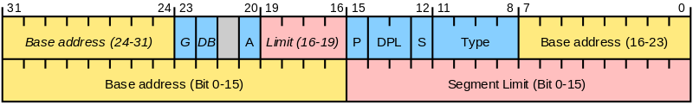
The Global Descriptor Table
Segment Descriptor:
gdt:
SEG_NULLASM # null seg
SEG_ASM(STA_X|STA_R, 0x0, 0xffffffff) # code seg
SEG_ASM(STA_W, 0x0, 0xffffffff) # data seg
Notes:
This is what a segment descriptor looks like
Base address is stored in all 3 yellow places
Various permission bits
One of these tellss which rign you need to be to run on it.

Slide 67
# Switch from real to protected mode.
# Use a bootstrap GDT that makes
# virtual addresses map directly to
# physical addresses so that the
# effective memory map doesn't change
# during the transition.
lgdt gdtdesc
movl %cr0, %eax
orl $CR0_PE, %eax
movl %eax, %cr0
Notes:
Transitioning into protected mode by using a special CPU register

Slide 68
Protected Mode
Finally we can jump into protected mode. The change happens only once a segment register is modified, so we execute a long jump to set %cs
From here on out, we're executing 32-bit x86 code
ljmp $(SEG_KCODE<<3), $start32

Slide 69
.code32 # Tell assembler to generate 32-bit code now.
start32:
# Set up the protected-mode data segment registers
movw $(SEG_KDATA<<3), %ax # Our data segment selector
movw %ax, %ds # -> DS: Data Segment
movw %ax, %es # -> ES: Extra Segment
movw %ax, %ss # -> SS: Stack Segment
movw $0, %ax # Zero segments not ready for use
movw %ax, %fs # -> FS
movw %ax, %gs # -> GS
Notes:
Set some segment registers for 32 bit protected mode

Slide 70
Onward to C
Finally, we can set up the stack and jump into C code
The stack pointer is set to 0x7c00 – the address of the start of the bootloader
# Set up the stack pointer and call into C.
movl $start, %esp
call bootmain
Notes:
Only bootloader is running

Slide 71
bootmain.c
Reads in the kernel header from the hard disk
Parses the kernel headers – it's a standard ELF (Executable and Linkable Format) file that gcc emits
Reads each section (kernel code, data) into memory at the address specified in the ELF headers
Finally, calls the entry point defined in the ELF file
Notes:
All the OS code doesn’t fit on 512 bytes.
Kernel is just a big program.
Kernel is in ELF. Format because that’s what gcc spits out by default.
Here’s the code/data
Finally reads the address of main function

Slide 72
elf = (struct elfhdr*)0x10000; // scratch space
// Read 1st page off disk
readseg((uchar*)elf, 4096, 0);
// Is this an ELF executable?
if(elf->magic != ELF_MAGIC)
return; // let bootasm.S handle error
// Load each program segment (ignores ph flags).
ph = (struct proghdr*)((uchar*)elf + elf->phoff);
eph = ph + elf->phnum;
for(; ph < eph; ph++){
pa = (uchar*)ph->paddr;
readseg(pa, ph->filesz, ph->off);
if(ph->memsz > ph->filesz)
stosb(pa + ph->filesz, 0, ph->memsz - ph->filesz);
}
// Call the entry point from the ELF header.
// Does not return!
entry = (void(*)(void))(elf->entry);
entry();
Notes:
Make up an address and we are just picking it in 0x10,000
because we know all the code that’s running which is ours.
Read the first 4096 from the harddrive
Read each section and putting over

Slide 73
kernel.ld
The kernel will eventually be loaded at 0x80100000 (virtual)
For now though, we have only physical memory, not virtual memory
Luckily, we can use a linker script to specify the physical load address, along with the entry point

Slide 74
/* Simple linker script for the JOS kernel.
See the GNU ld 'info' manual ("info ld") to learn the syntax. */
OUTPUT_FORMAT("elf32-i386", "elf32-i386", "elf32-i386")
OUTPUT_ARCH(i386)
ENTRY(_start)
SECTIONS
{
/* Link the kernel at this address: "." means the current address */
/* Must be equal to KERNLINK */
. = 0x80100000;
.text : AT(0x100000) {
*(.text .stub .text.* .gnu.linkonce.t.*)
}
Note that 0x80100000 = 0x100000 + 0x80000000 So during early boot we can translate between "virtual" and physical addresses by simple addition & subtraction
Notes:
You can define a simple mapping between physical and virtual

Slide 75
Reading from the Hard Drive
You can talk to an IDE hard drive using port I/O (PIO)
This mode is not very fast, but it's simple to implement
An alternative is DMA (Direct Memory Access), which allows data transfer to bypass the CPU
xv6 only implements PIO mode
Notes:
Using the x86 in/out instructions
Later we will talk about Direct Memory Address

Slide 76
// Read a single sector at offset into dst.
void
readsect(void *dst, uint offset)
{
// Issue command.
waitdisk();
outb(0x1F2, 1); // count = 1
outb(0x1F3, offset);
outb(0x1F4, offset >> 8);
outb(0x1F5, offset >> 16);
outb(0x1F6, (offset >> 24) | 0xE0);
outb(0x1F7, 0x20); // cmd 0x20 - read sectors
// Read data.
waitdisk();
insl(0x1F0, dst, SECTSIZE/4);
}
Notes:
Outb functions
Each one i
Inline assembly
Void outb(int port, int value)
{
Asm(“ outb a1, a2”)
}
This is how we get the kernel from the hard drive into memory

Slide 77
Kernel Entry Point
Defined in entry.S
This is where we finally turn on paging, but for now we just use a very simple mapping: 0x80000000 => 0x00000000

Slide 78
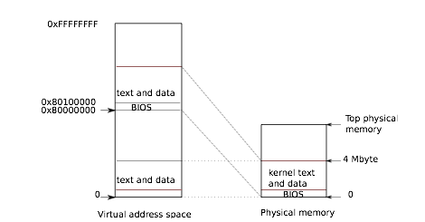
Notes:
Virtual vs physical memory

Slide 79
# Entering xv6 on boot processor, with paging off.
.globl entry
entry:
# Turn on page size extension for 4Mbyte pages
movl %cr4, %eax
orl $(CR4_PSE), %eax
movl %eax, %cr4
# Set page directory
movl $(V2P_WO(entrypgdir)), %eax
movl %eax, %cr3
# Turn on paging.
movl %cr0, %eax
orl $(CR0_PG|CR0_WP), %eax
movl %eax, %cr0
Notes:
CRO flag turns on paging

Slide 80
Kernel Main
// Bootstrap processor starts running C code here.
// Allocate a real stack and switch to it, first
// doing some setup required for memory allocator to work.
int
main(void)
{
kinit1(end, P2V(4*1024*1024)); // phys page allocator
kvmalloc(); // kernel page table
mpinit(); // collect info about this machine
lapicinit();
seginit(); // set up segments
cprintf("\ncpu%d: starting xv6\n\n", cpu->id);
picinit(); // interrupt controller
ioapicinit(); // another interrupt controller
consoleinit(); // I/O devices & their interrupts
uartinit(); // serial port
pinit(); // process table
tvinit(); // trap vectors
binit(); // buffer cache
fileinit(); // file table
ideinit(); // disk
if(!ismp)
timerinit(); // uniprocessor timer
startothers(); // start other processors
kinit2(P2V(4*1024*1024), P2V(PHYSTOP)); // must come after startothers()
userinit(); // first user process
// Finish setting up this processor in mpmain.
mpmain();
}
Notes:
The kernel is just a program
Finally sets up the first user process

Slide 81
Creating the First Process
This happens in userinit() – after we've initialized lots of other hardware [proc.c:79]
The first process will run the code in initcode.S
To do that it needs:
A process structure filled out and assigned a slot in the process table (allocproc())
An address space (setupkvm())
Notes:
In unix like systems are created by copies of an existing process
The first process is this one
With virtual memory each process can have it’s own private view of memory which is what we call addresspace

Slide 82
initcode.S
# exec(init, argv)
.globl start
start:
pushl $argv
pushl $init
pushl $0 // where caller pc would be
movl $SYS_exec, %eax
int $T_SYSCALL
[...]
# char init[] = "/init\0";
init:
.string "/init\0"
Notes:
The first call tha it makes is the exec system call
That first process is gonna start the shell.
Once that happens the boot process is done

